Slide 1
CS-2074 Computer Organization Laboratory A.Y. 2021-2022(SPRING)

Slide 2
Introduction to Verilog
In the early days of integrated circuits, engineers had to sit down and physically draw transistors and their connections on paper to design them such that it can be fabricated on silicon.
Bigger and complex circuits demanded more engineers, time and other resources and soon enough there was a need to have a better way of designing integrated circuits.
VHDL (Very High Speed Integrated Circuit Hardware Description Language) was developed to enhance the design process by allowing engineers to describe functionality of the desired hardware and let automation tools convert that behavior into actual hardware elements like combinational gates and sequential logic.
Verilog was developed to simplify the process and make the Hardware Description Language (HDL) more robust and flexible. Verilog is the most popular HDL used and practiced throughout the semiconductor industry.

Slide 3
Verilog Syntax
Lexical conventions in Verilog are similar to C.
All lines should be terminated by a semi-colon (;)
Verilog is case-sensitive, so var_a and var_A are different.
Comments :
A single line comment starts with //
A multiple-line comment starts with /* and ends with */
Whitespace : Whitespace is a term used to represent the characters for spaces, tabs, newlines and formfeeds and usually ignored by Verilog except when it separates tokens or used inside string.

Slide 4
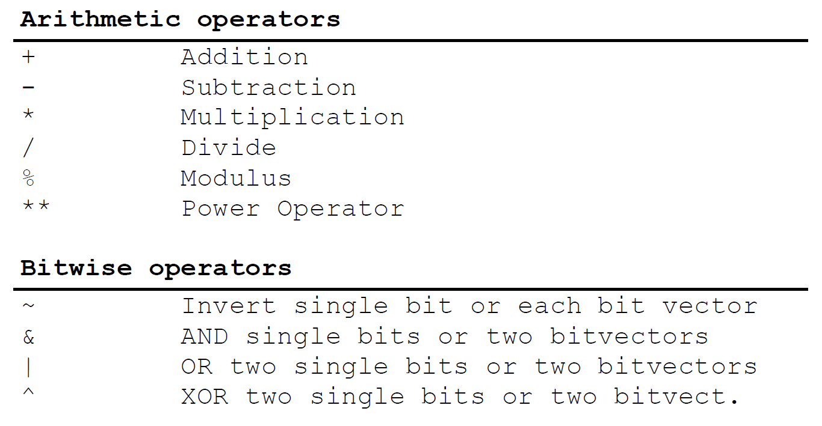
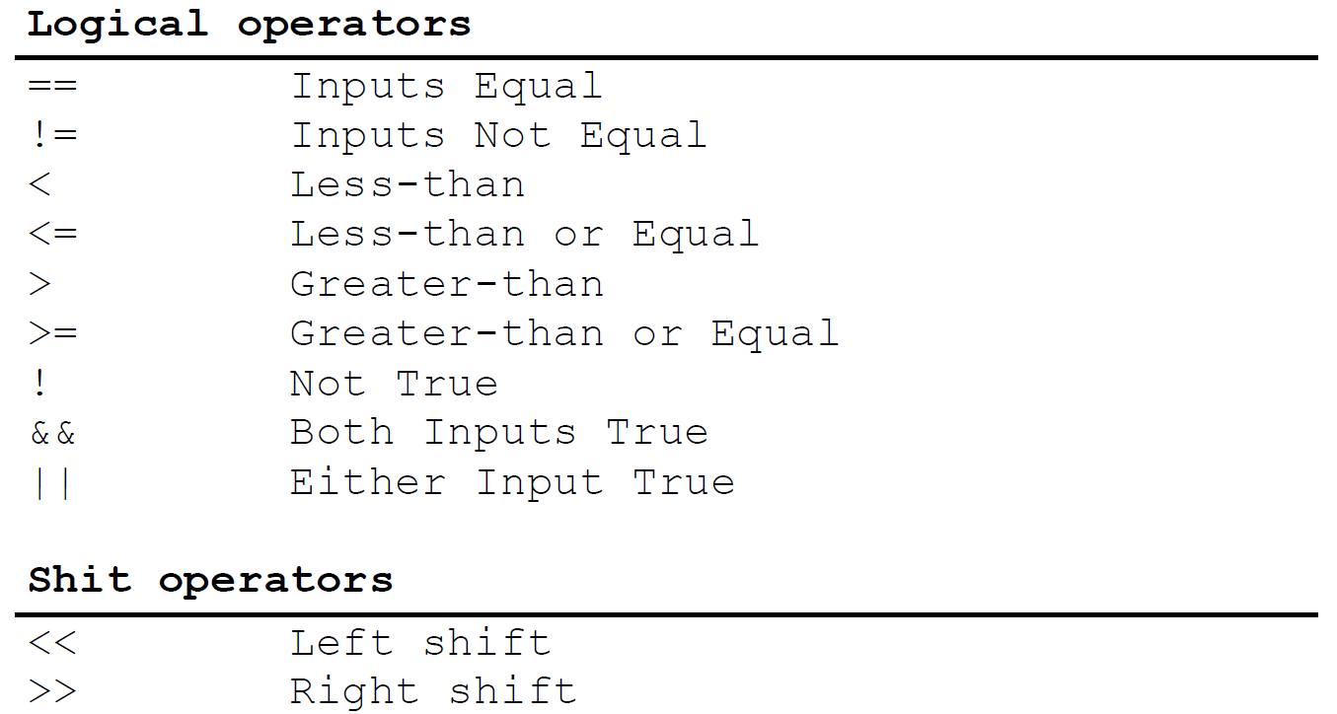
Operators in Verilog

Slide 5
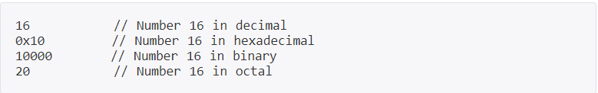
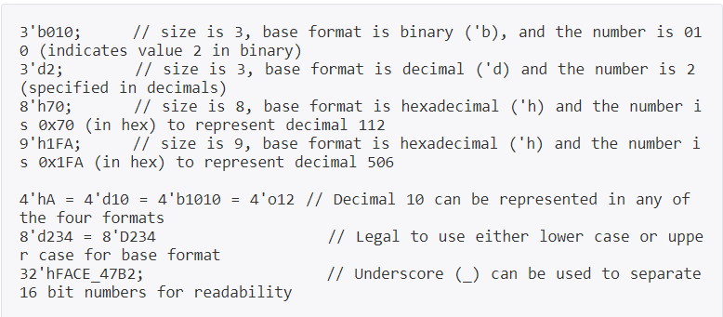
Number Format in Verilog
By default, Verilog simulators treat numbers as decimal, to represent numbers in different radix, certain rules have to be followed showed below :
Sized : Sized numbers are represented as shown below, where size is written only in decimal to specify number of bits in the number.

Slide 6

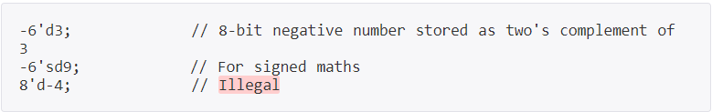
Number Format in Verilog cont.…
Unsized: Numbers without a base_format specification are decimal by default. Numbers without a size specification have a default number of bits depending on the type of simulator and machine.
Negative: Negative numbers are specified by placing a minus (-) sign before the size of the number. It is illegal to have minus (-) sign between base_format and number.

Slide 7
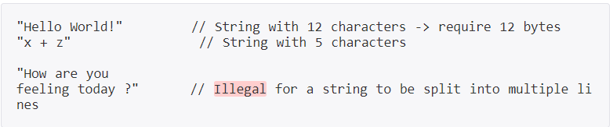
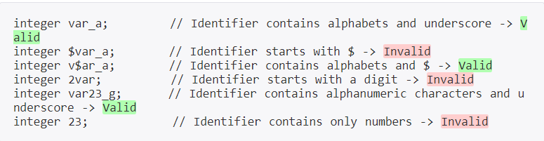
Strings : A sequence of characters enclosed in a double quote (" ") is called a string. It cannot be split into multiple lines and every character in the string take 1-byte to be stored.
Identifiers : Identifiers are names of variables so that they can be referenced later on. They are made up of alphanumeric characters ( [a-z][A-Z][0-9] ), underscores (_) or dollar sign ($) and are case sensitive. They cannot start with a digit or a dollar sign.

Slide 8
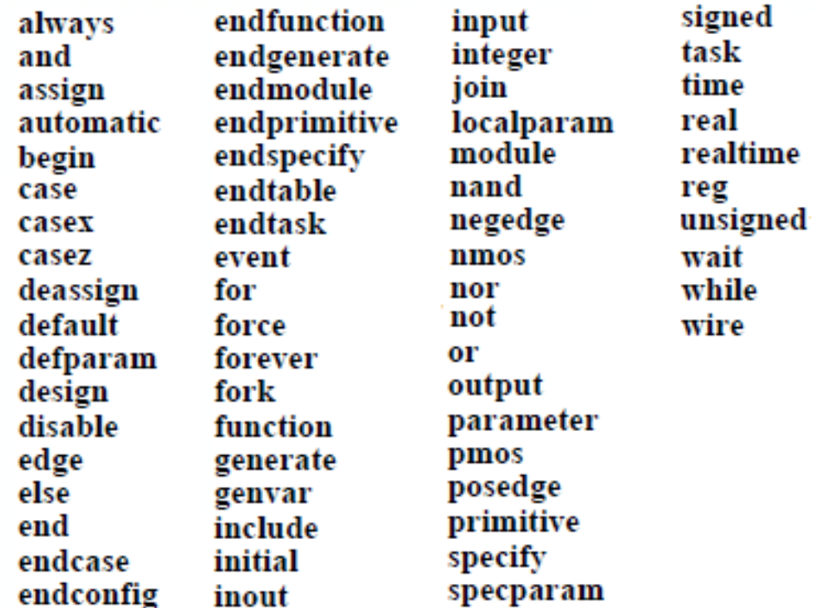
Keywords in Verilog

Slide 9
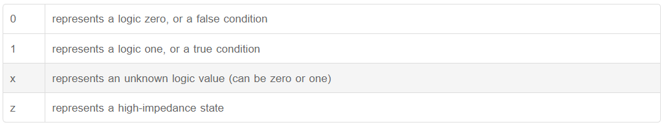
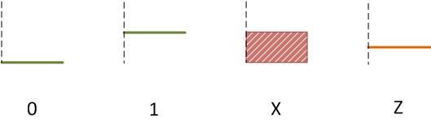
Data Types in Verilog
The primary intent of data-types in the Verilog language is to represent data storage elements like bits in flip-flop and transmission elements like wires that connect between logic gates and sequential structures.
What values do variables hold ?
Almost all data-types can only have one of the four different values as given below except for real and event data types.

Slide 10
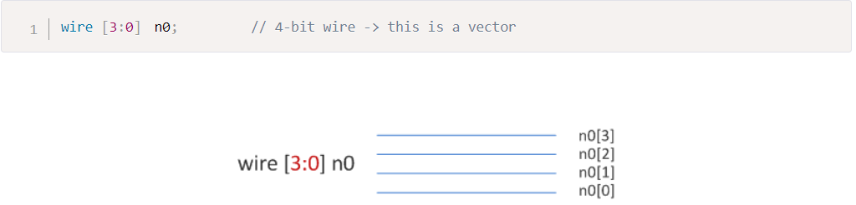
Nets and Variables
Nets : Nets are used to connect between hardware entities like logic gates and hence do not store any value on its own.
A wire is a Verilog data-type used to connect elements and to connect nets that are driven by a single gate or continuous assignment. The wire is similar to the electrical wire that is used to connect two components on a breadboard.
Variable : A variable on the other hand is an abstraction of a data storage element and can hold values.
Verilog data-type reg can be used to model hardware registers since it can hold values between assignments.
Other Datatypes
An integer is a general purpose variable of 32-bits wide that can be used for other purposes while modeling hardware and stores integer values.
A time variable is unsigned, 64-bits wide and can be used to store simulation time quantities for debugging purposes.
A real variable can store floating point values and can be assigned the same way as integer and reg.

Slide 11
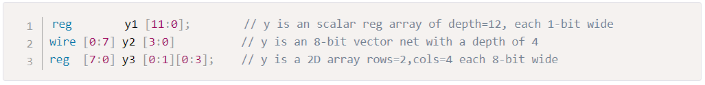
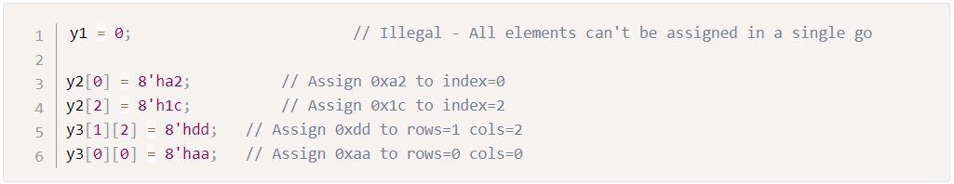
Arrays in Verilog
An array declaration of a net or variable can be either scalar or vector. Any number of dimensions can be created by specifying an address range after the identifier name and is called a multi-dimensional array. Arrays are allowed in Verilog for reg , wire , integer and real data types.
Assignment in Arrays

Slide 12
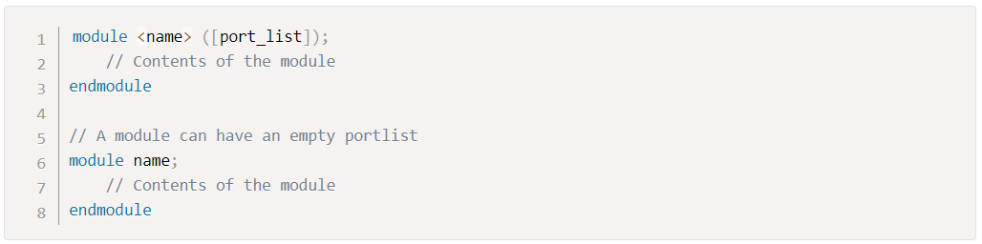
Verilog Module
A module is a block of Verilog code that implements a certain functionality. Module can be embedded within other modules and a higher level module can communicate with its lower level modules using their input and output ports.
Syntax
All variable declarations, dataflow statements, functions or tasks and lower module instances if any, must be defined within the module and endmodule keywords. There can be multiple modules with different names in the same file and can be defined in any order.

Slide 13
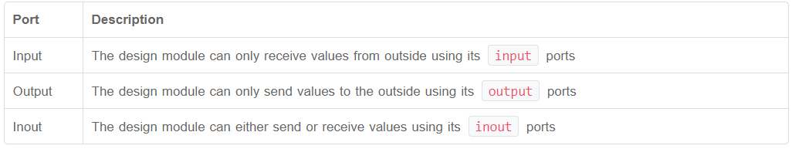
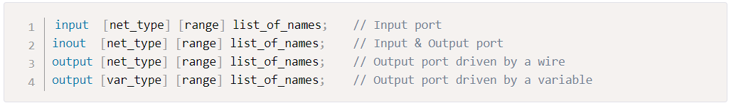
Verilog Ports
Ports are a set of signals that act as inputs and outputs to a particular module and are the primary way of communicating with it. Think of a module as a fabricated chip placed on PCB and it becomes quite oblivious that the only way to communicate with the chip is through its pins. Ports are like pins and are used by design to send and receive signals from the outside world.
Types of Ports
Syntax

Slide 14
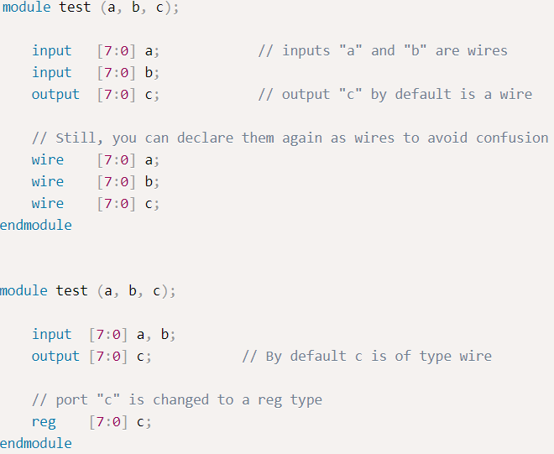
Port Variations
Verilog 1995

Slide 15
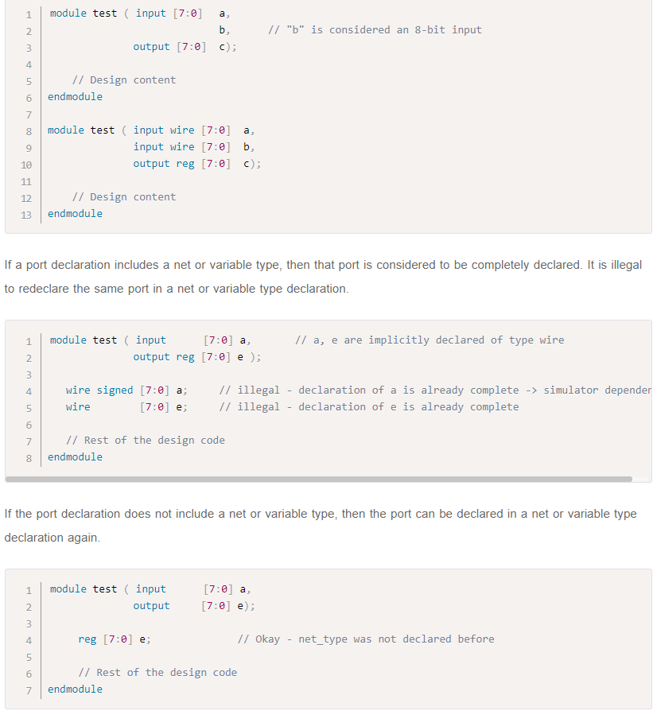
Verilog 2001 onwards (More ANSI-C Style)

Slide 16
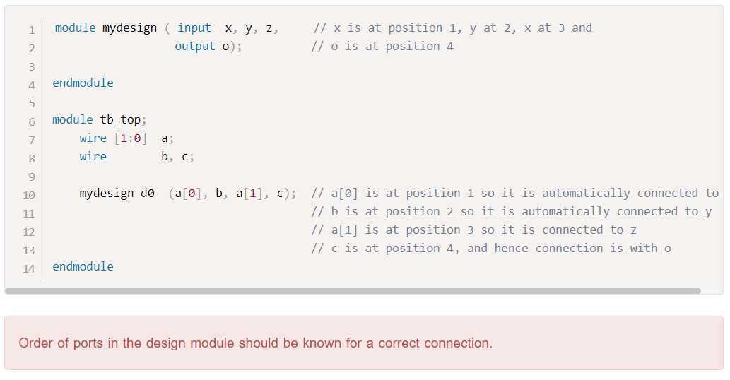
Verilog Module Instantiation
Port Connection by ordered list

Slide 17
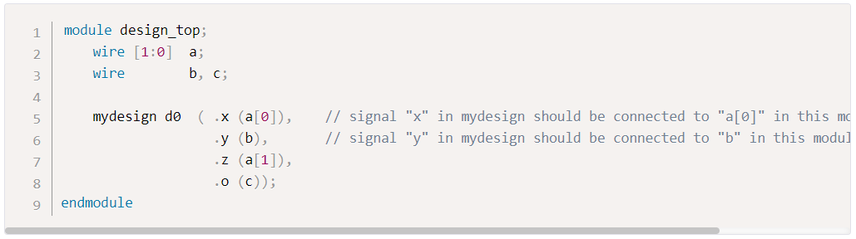
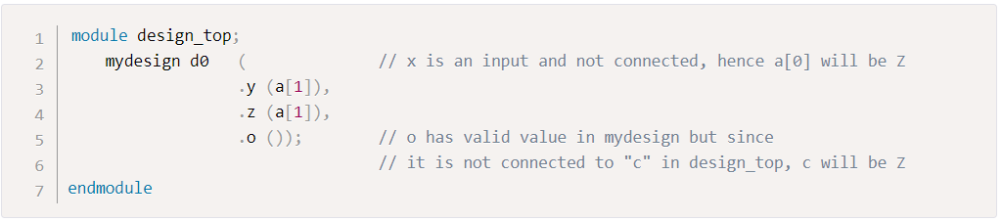
Port Connection by name
Unconnected/Floating Ports

Slide 18
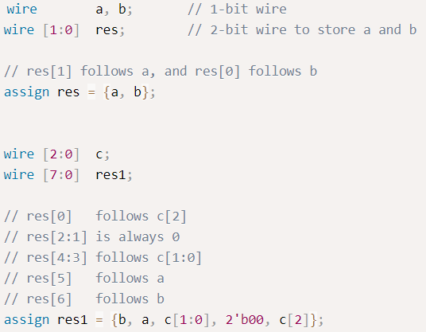
Verilog Concatenation
Multi-bit Verilog wires and variables can be clubbed together to form a bigger multi-net wire or variable using ‘{‘ and ‘}’ separated by commas. Concatenation is also allowed to have expressions and sized constants as operands in addition to wires and variables.
Size of each operand must be known in order to calculate the complete size of concatenation.

Slide 19
Gate Level Modelling
Most digital designs are done at a higher level of abstraction like RTL, although at times it becomes intuitive to build smaller deterministic circuits at a lower level by using combinational elements. Modeling done at this level is usually called gate level modeling as it involves gates and has a one relation between a hardware schematic and the Verilog code.
Verilog supports a few basic logic gates known as primitives as they can be instantiated like modules since they are already predefined.
Primitives gate List are -
and(out,in1,in2)
or(out,in1,in2)
xor(out,in1,in2)
nand(out,in1,in2)
nor(out,in1,in2)
xnor(out,in1,in2)
buf(out,in1)
not(out,in1)

Slide 20
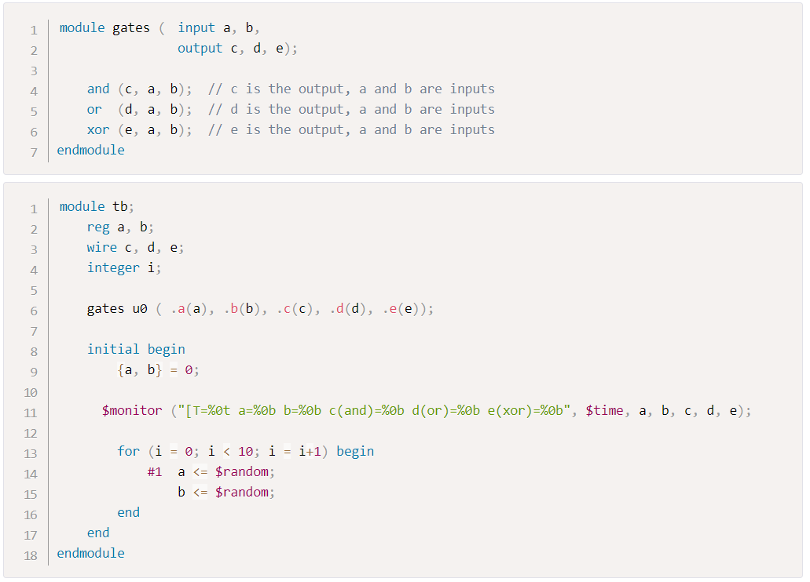
Example - 1

Slide 21
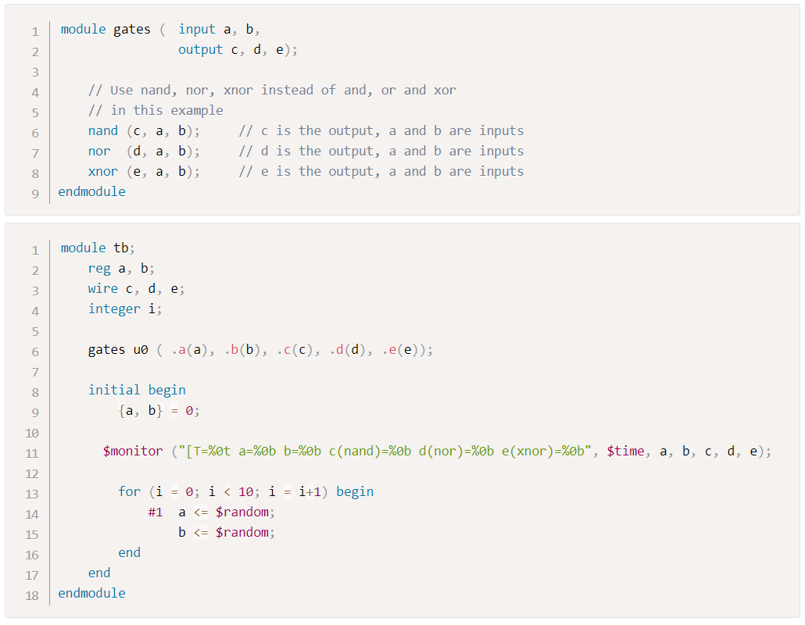
Example - 2

Slide 22
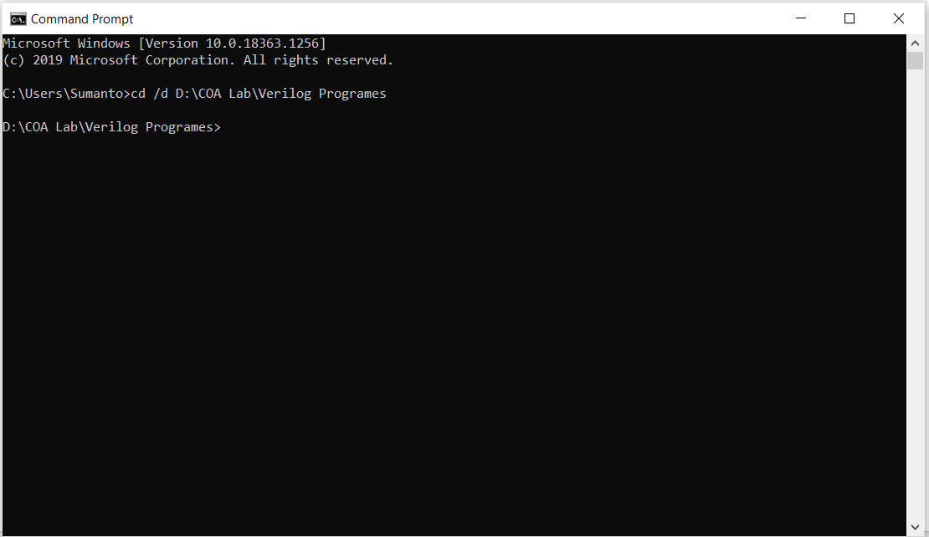
Open Command Prompt and change the directory where your Verilog files are located.

Slide 23
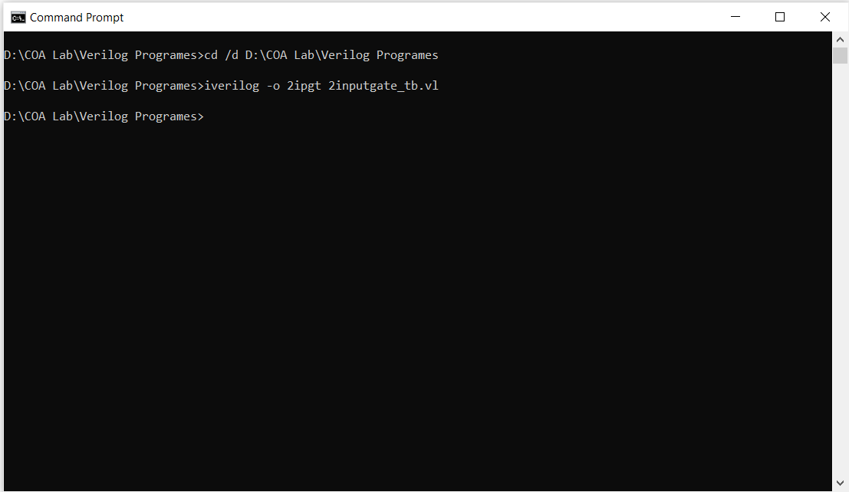
Compile the program with a command : iverilog -o output_file_name input_file_name.vl

Slide 24
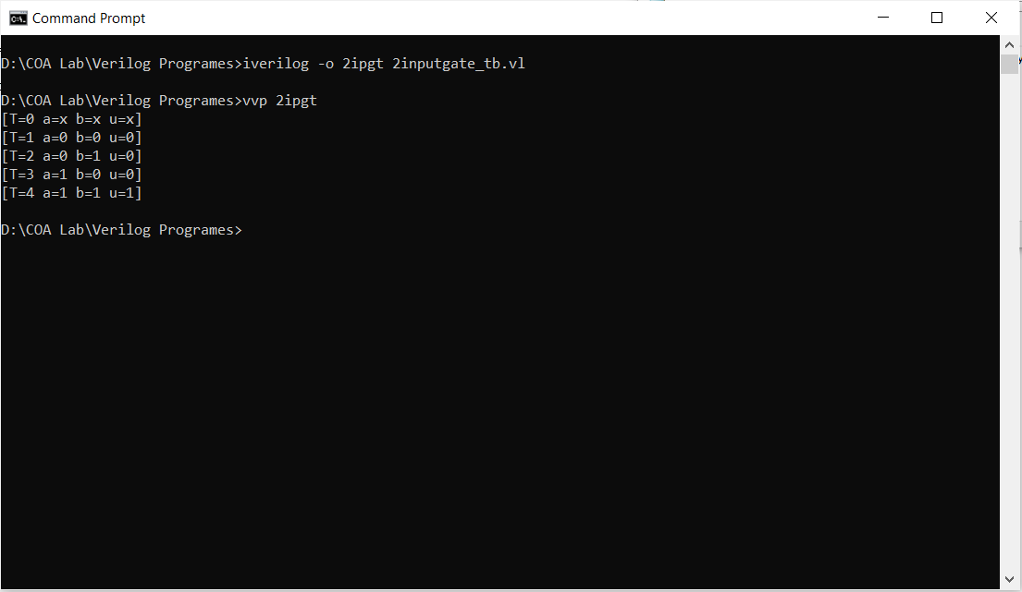
Run the code with a command : vvp output_file_name

